Slide 1

Factory Reallocation & Shipping Optimization Using Machine Learning and Recommendation Systems
P Bhanu
Data analyst internship

Slide 2
Introduction
Supply chain optimization is important for business efficiency.
Shipping delays increase operational costs.
Machine learning can improve logistics decisions.
This project focuses on lead time prediction and factory optimization.

Slide 3
Problem Statement
Businesses often face:
Long shipment delays
Inefficient factory allocation
Reduced profitability
Lack of operational insights
Proposed Solution
Develop an intelligent recommendation system using machine learning.

Slide 4
Project Objectives
Data preprocessing and cleaning
Exploratory data analysis
Lead time analysis
Machine learning prediction
Recommendation system development
Streamlit dashboard creation

Slide 5
Dataset Description
Dataset Used : Nassau Candy Distributor Dataset
Dataset Features
Product Name
Region
Ship Mode
Sales
Gross Profit
Cost
Order Date
Ship Date

Slide 6
Technologies Used
Tools & Technologies
Technology | Purpose
Python | Programming
Pandas | Data Analysis
NumPy | Numerical Operations
Matplotlib | Visualization
Scikit-learn | Machine Learning
Streamlit | Dashboard
Google Colab | Development Environment

Slide 7
Data Preprocessing
Data Preprocessing Steps
Dataset loading
Missing value handling
Date conversion
Lead time creation
Feature engineering
Encoding categorical variables

Slide 8
Exploratory Data Analysis
EDA Visualizations
Add Screenshots:
Sales by Region Graph
Correlation Heatmap
Lead Time Distribution
Insights:
Some regions showed higher sales.
Lead time affects operational efficiency.
Sales and profit are positively correlated.

Slide 9
Machine Learning Models
Models Implemented
Linear Regression
Random Forest Regressor
Gradient Boosting Regressor
Evaluation Metrics
MAE
RMSE
R² Score

Slide 10
Model Results
Model Performance
Model | MAE | RMSE | R²
Linear Regression | 1.49 | 1.69 | -0.0008
Random Forest | 1.52 | 1.77 | -0.088
Gradient Boosting | 1.49 | 1.70 | -0.006
Best Model
Gradient Boosting Regressor

Slide 11
Recommendation System
Recommendation Logic
High lead time → Recommend Faster Factory
Moderate lead time → Consider Alternative Factory
Low lead time → Current Factory Efficient
Optimization Parameters
Lead Time
Profit Margin
Optimization Score

Slide 12
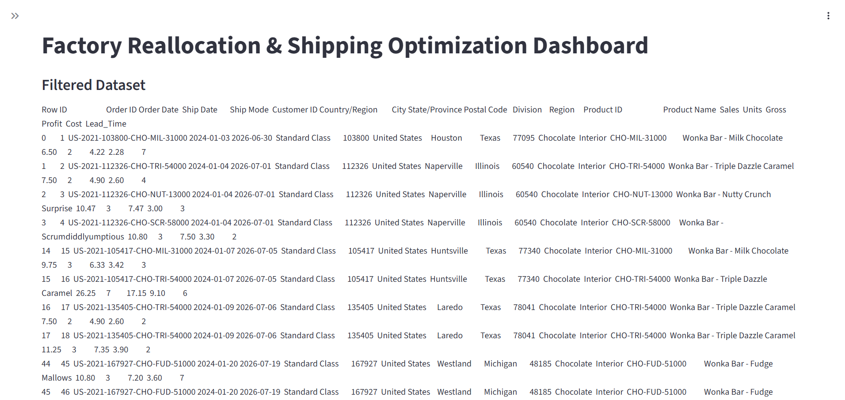
Streamlit Dashboard

Slide 13
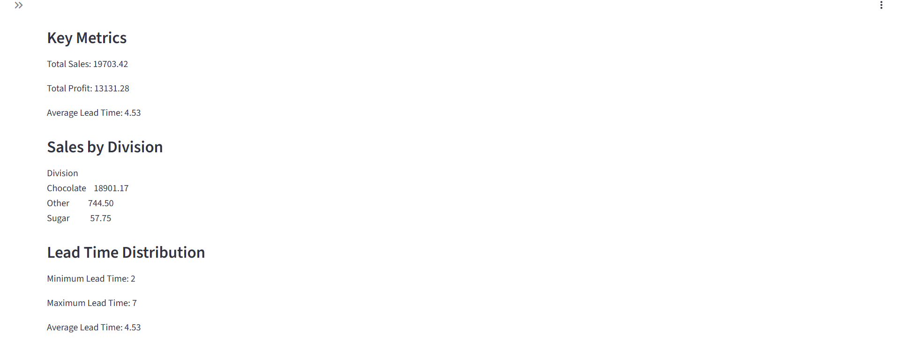

Slide 14
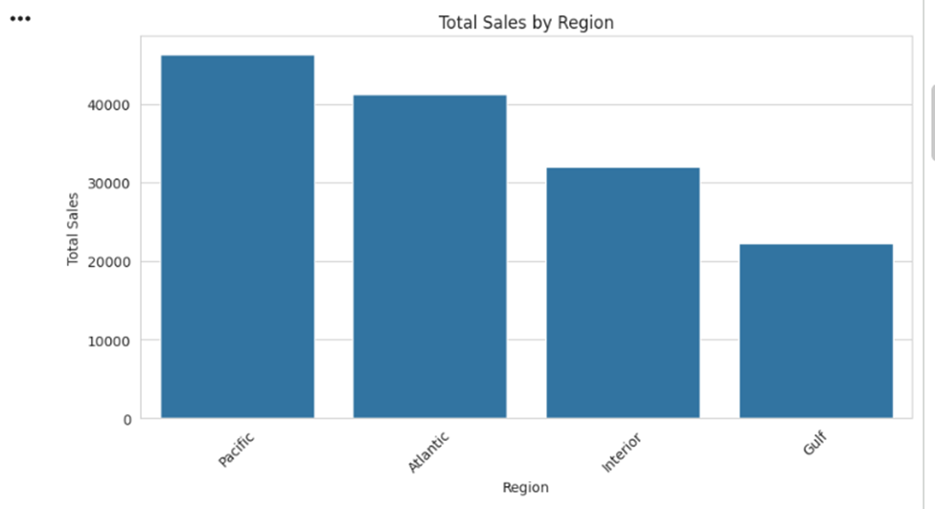
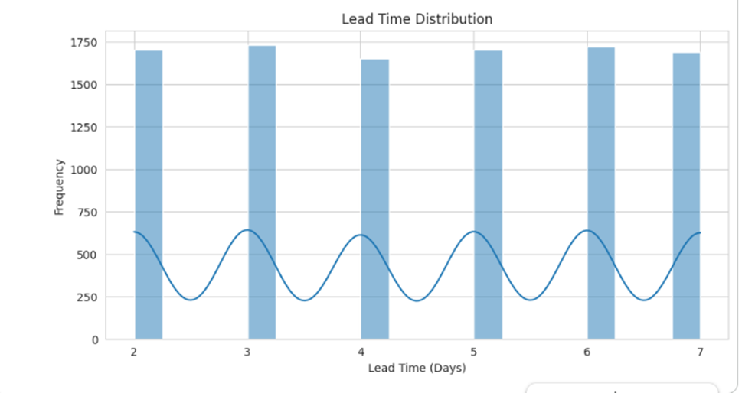

Slide 15
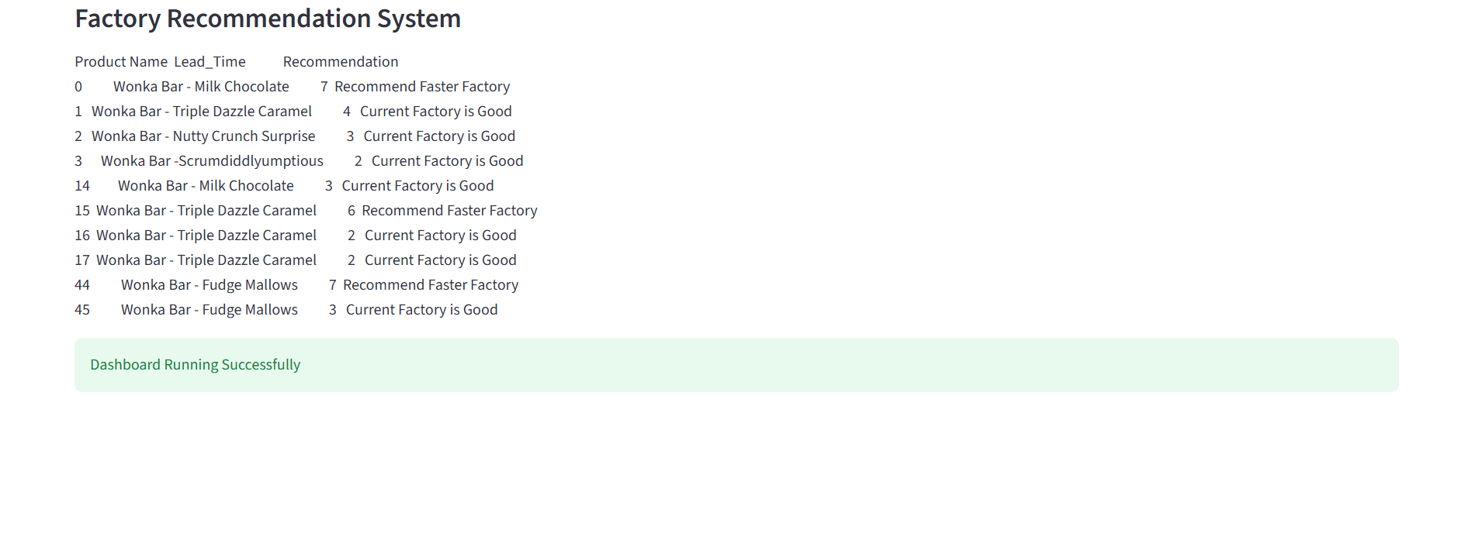

Slide 16
Results & Findings
Major Findings
Machine learning improves logistics analysis.
Recommendation systems support optimization.
Dashboard enables business monitoring.
Lead time impacts operational efficiency.

Slide 17
Conclusion
Successfully developed ML-based optimization system.
Built recommendation engine.
Created interactive dashboard.
Improved operational analysis using data science.

Slide 18
Future Scope
Future Enhancements
Real-time shipment tracking
Deep learning models
Cloud deployment
ERP integration
Advanced forecasting systems

Slide 19


